Slide 1

Sleep Cycles
BIS 15L Group7_Psychology
Discover the mysteries of sleep.
Knowing the impact on Productivity, Mood, and Stress
Yitong Sun
Hanxu Sha
Lu Liang
Tianchen Li

Slide 2
Agenda
BIS 15L Group7_Psychology
Introduction
Methods
Results
Conclusions

Slide 3

Sleep is …
BIS 15L Group7_Psychology
How do daily habits affect sleep quality and overall well-being?
We aim to examines how gender and lifestyle factors (caffeine, exercise, screen time) impact productivity, mood, and stress.
Factors

Slide 4
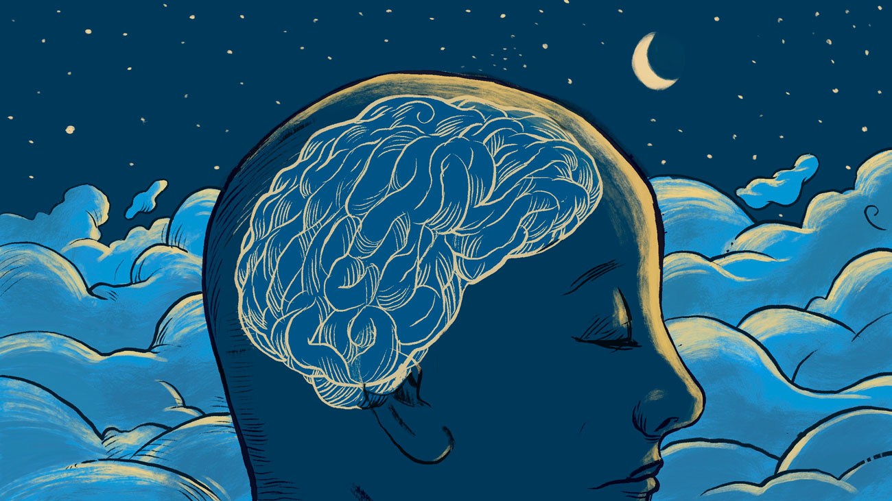
Our Methods
BIS 15L Group7_Psychology
Data Analysis
ggplot：
scatter
boxplot
shiny app

Slide 5
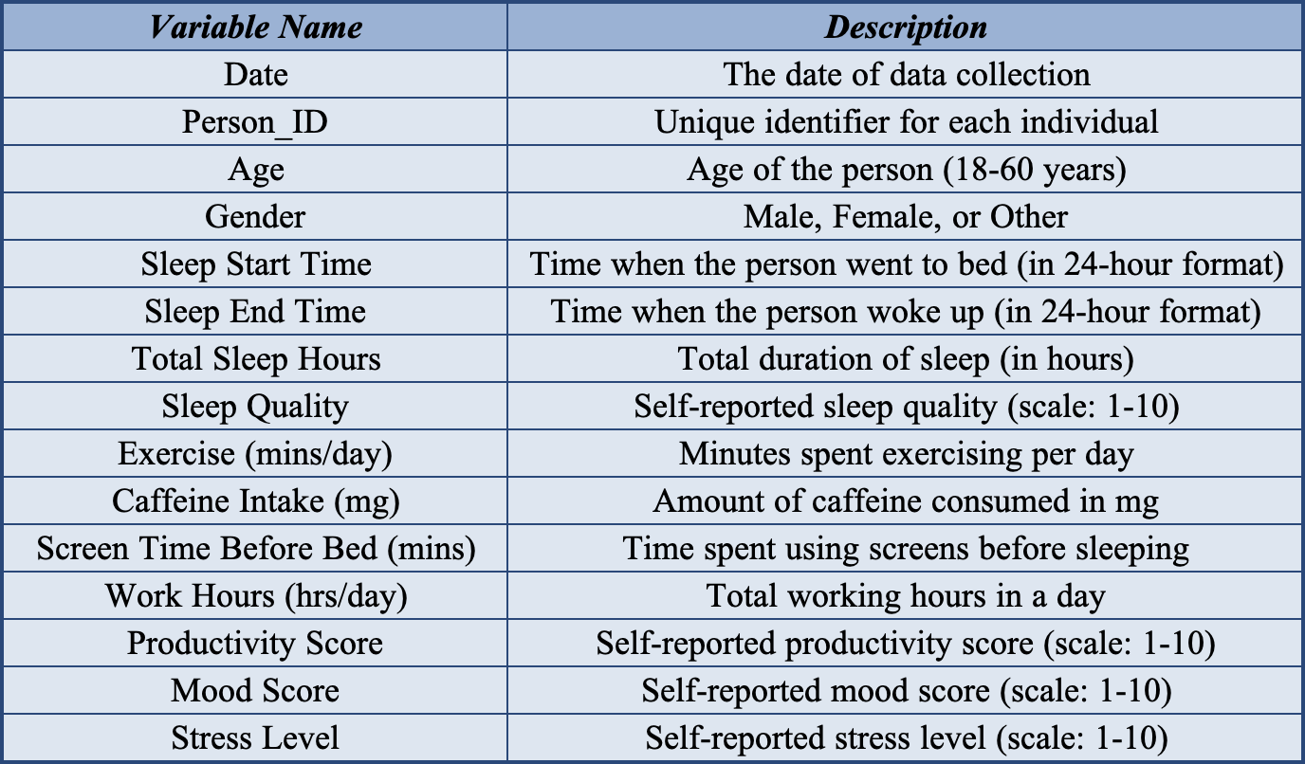
Data Exploration
BIS 15L Group7_Psychology
Data are tidy!
# 5000 entries
# 15 variables
# Tracks sleep habits and their impact on productivity, mood, and stress levels.
https://www.kaggle.com/datasets/adilshamim8/sleep-cycle-and-productivity?select=sleep_cycle_productivity.csv

Slide 6
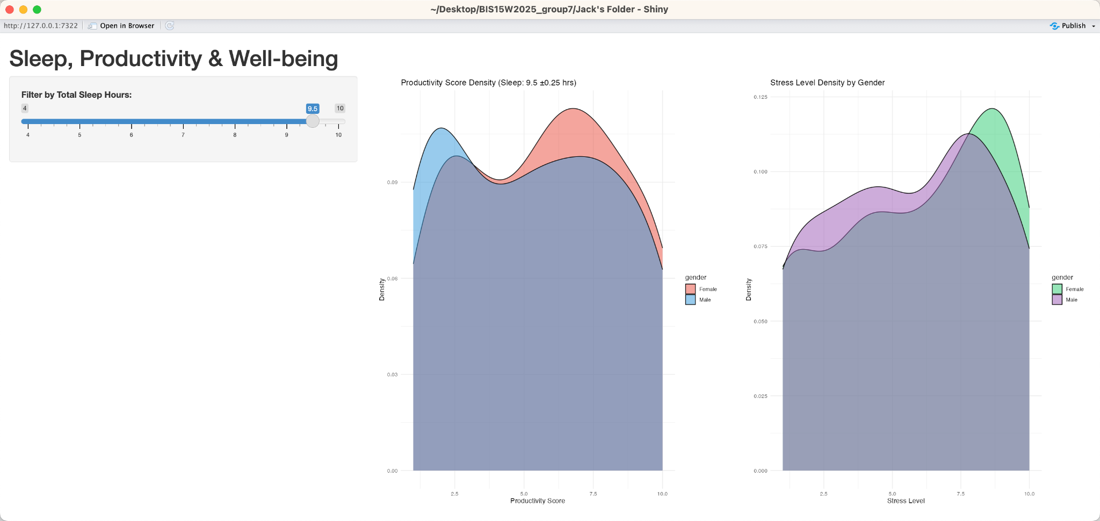
Sleep Hours v.s. Stress & Productivity
Tianchen Li
BIS 15L Group7_Psychology
Does sleeping more lead to better performance and less stress?

Slide 7
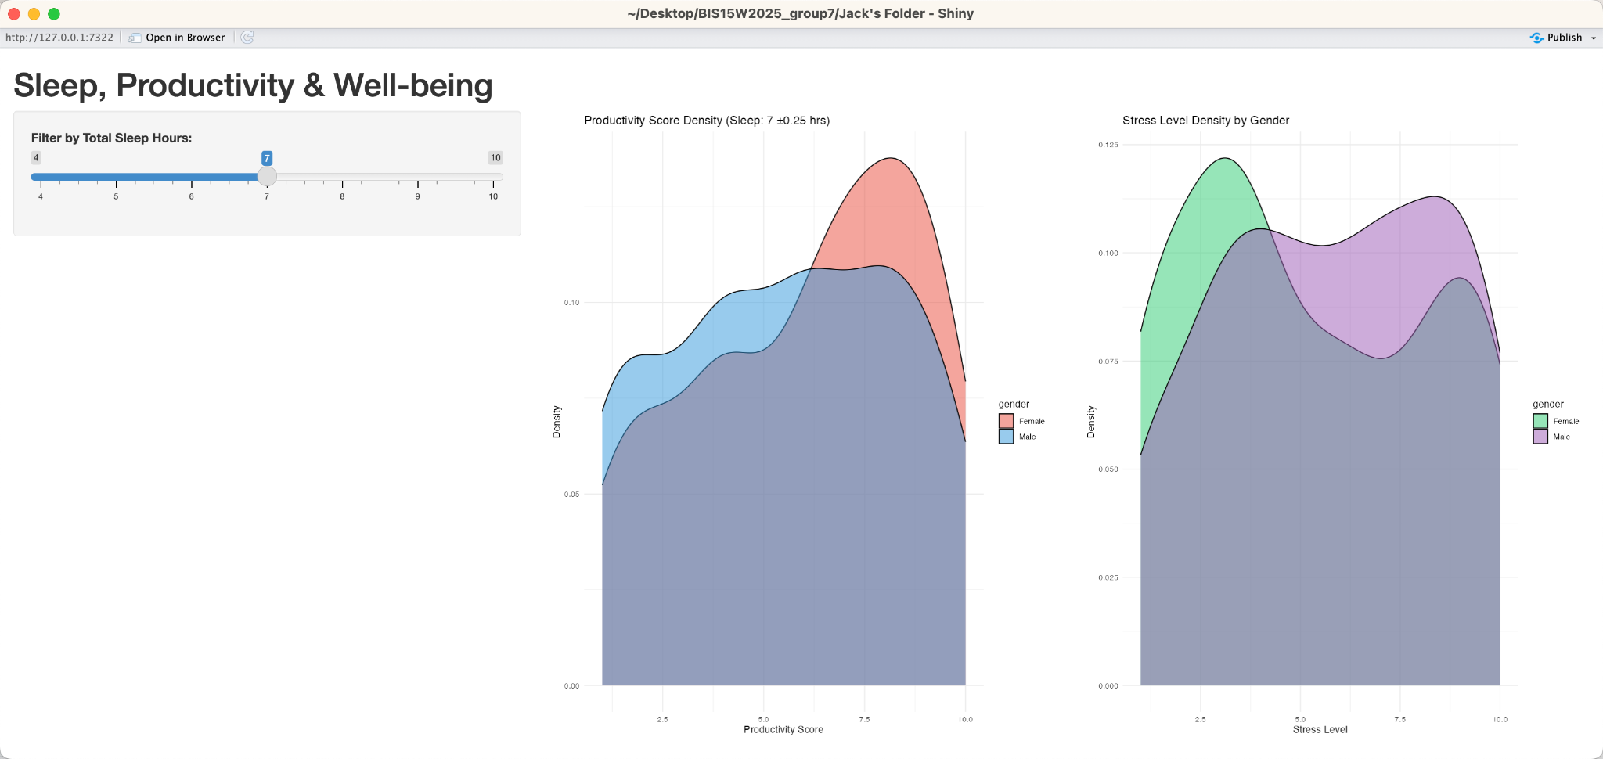
Sleep Hours v.s. Stress & Productivity
Tianchen Li
BIS 15L Group7_Psychology
Is there a Balance Point?

Slide 8
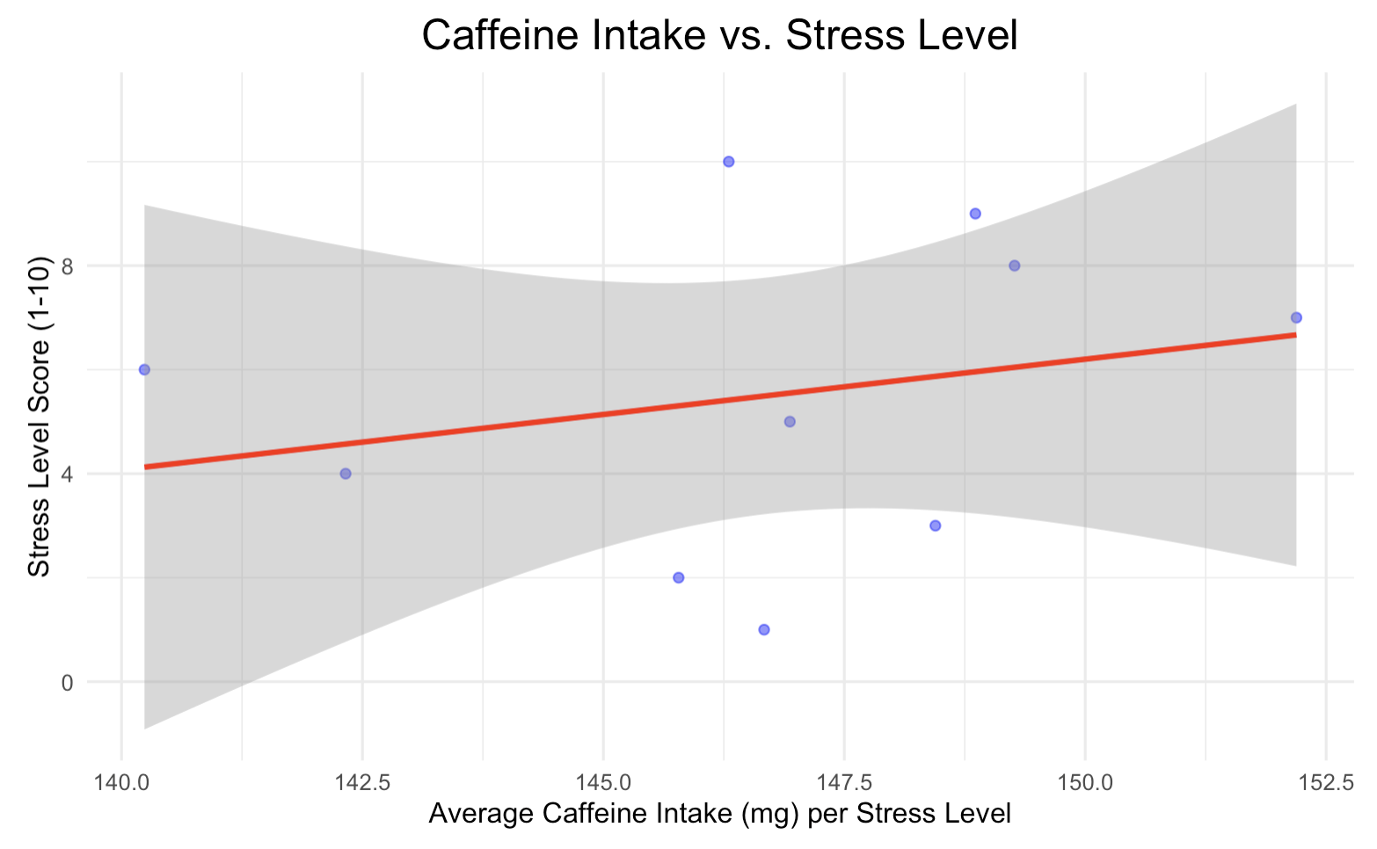
Stress Level and Lifestyle
Hanxu Sha
BIS 15L Group7_Psychology
Does high caffeine intake correlate with higher stress levels?
Correlation coefficient: 0.009029
Tiny positive correlation
As caffeine consumption increases, stress levels also tend to rise

Slide 9
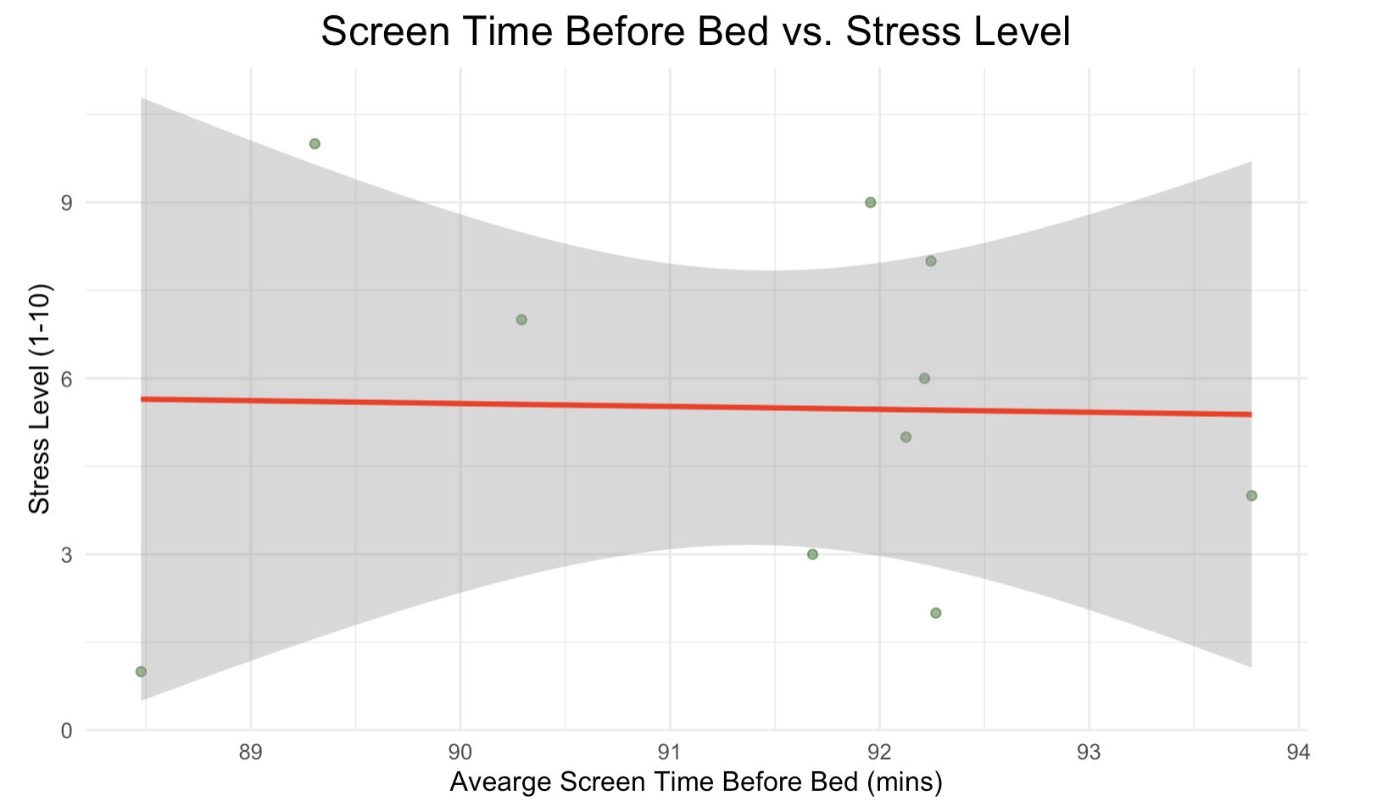
Stress Level and Lifestyle
Hanxu Sha
BIS 15L Group7_Psychology
Is screen time before bed associated with increased stress?
Correlation coefficient： -0.000814
Almost no correlation (Tiny negative correlation)
As screen time before bed increases, stress levels tend to decrease!

Slide 10
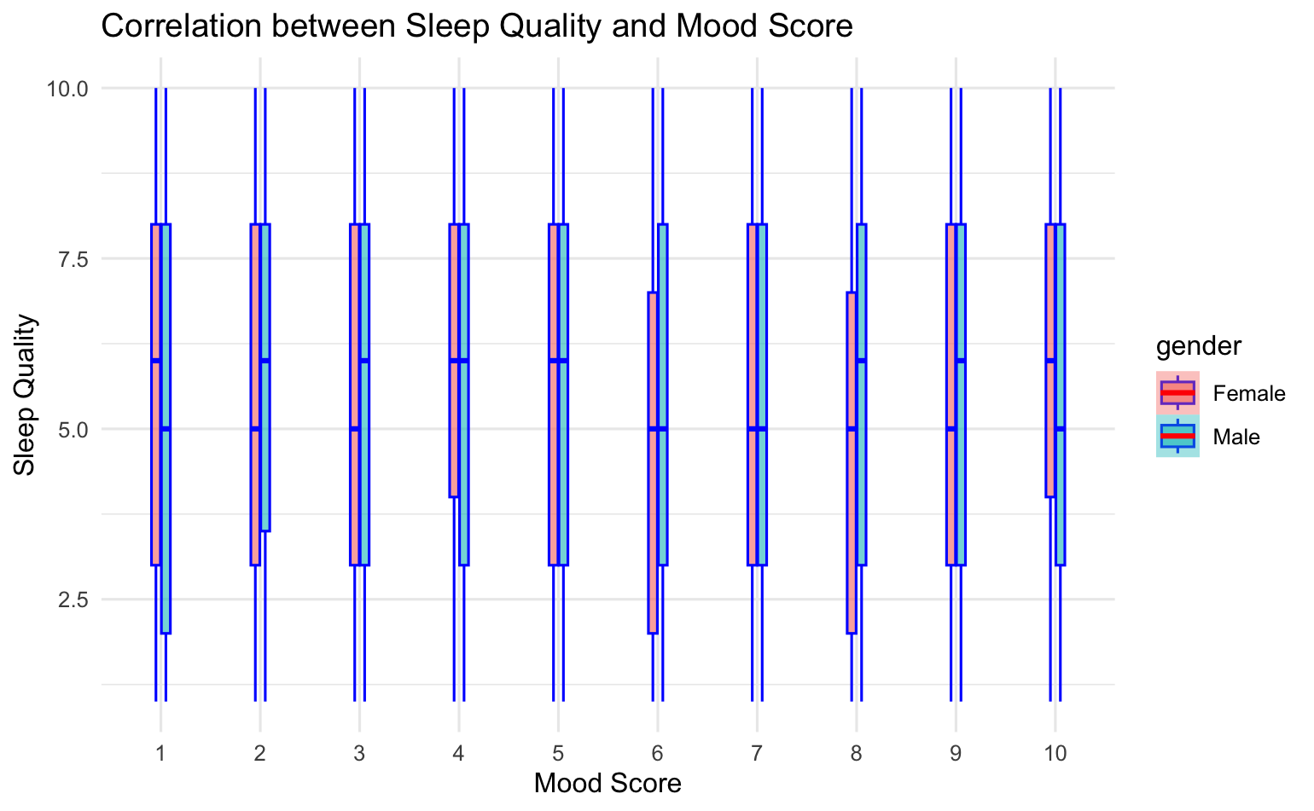
Mood vs. Sleep Quality
Yitong Sun
BIS 15L Group7_Psychology
p-value = 0.7326
cor = 0.005868496
No correlation.

Slide 11
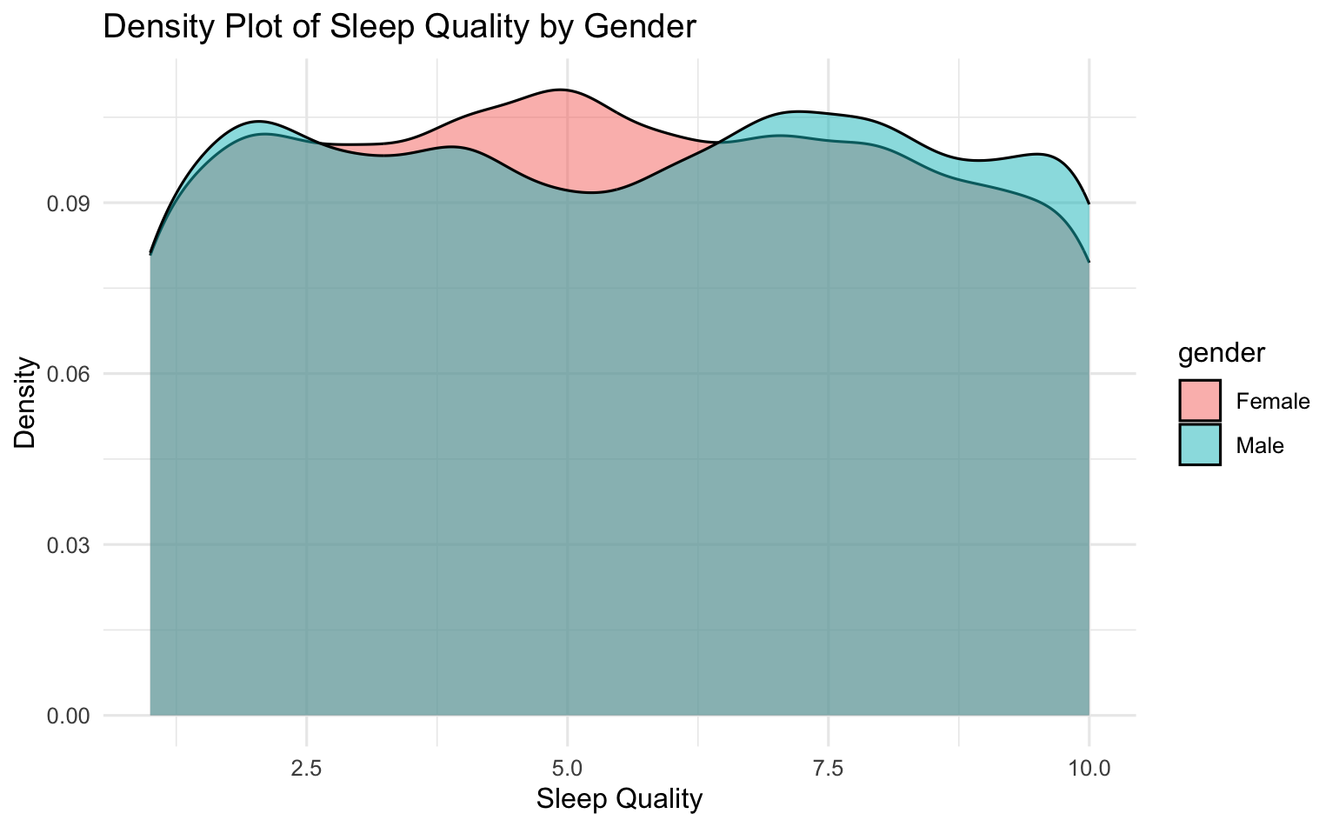
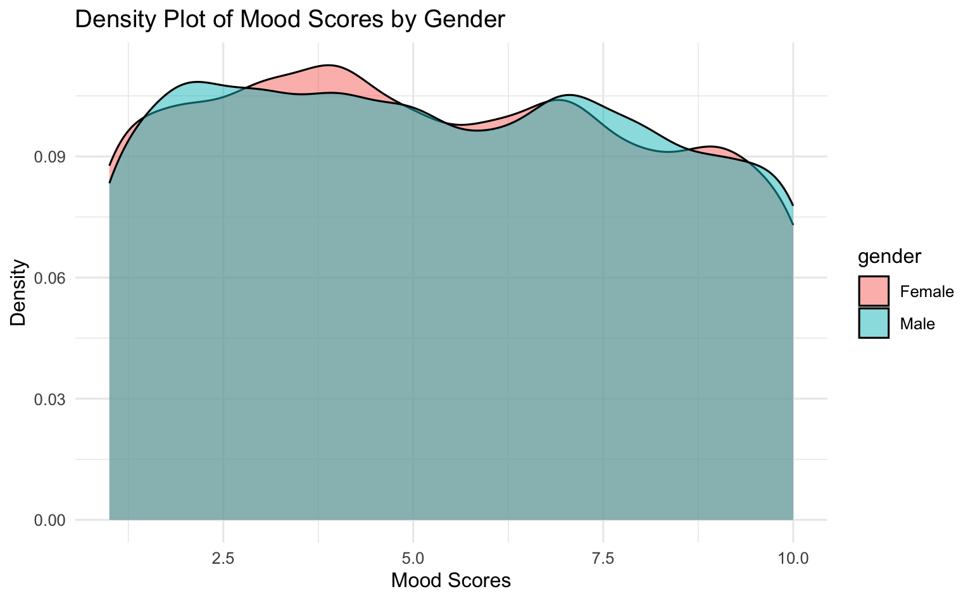
Gender Perspectives
Yitong Sun
BIS 15L Group7_Psychology
Gender had little effect on Sleep Quality and Mood Scores.

Slide 12
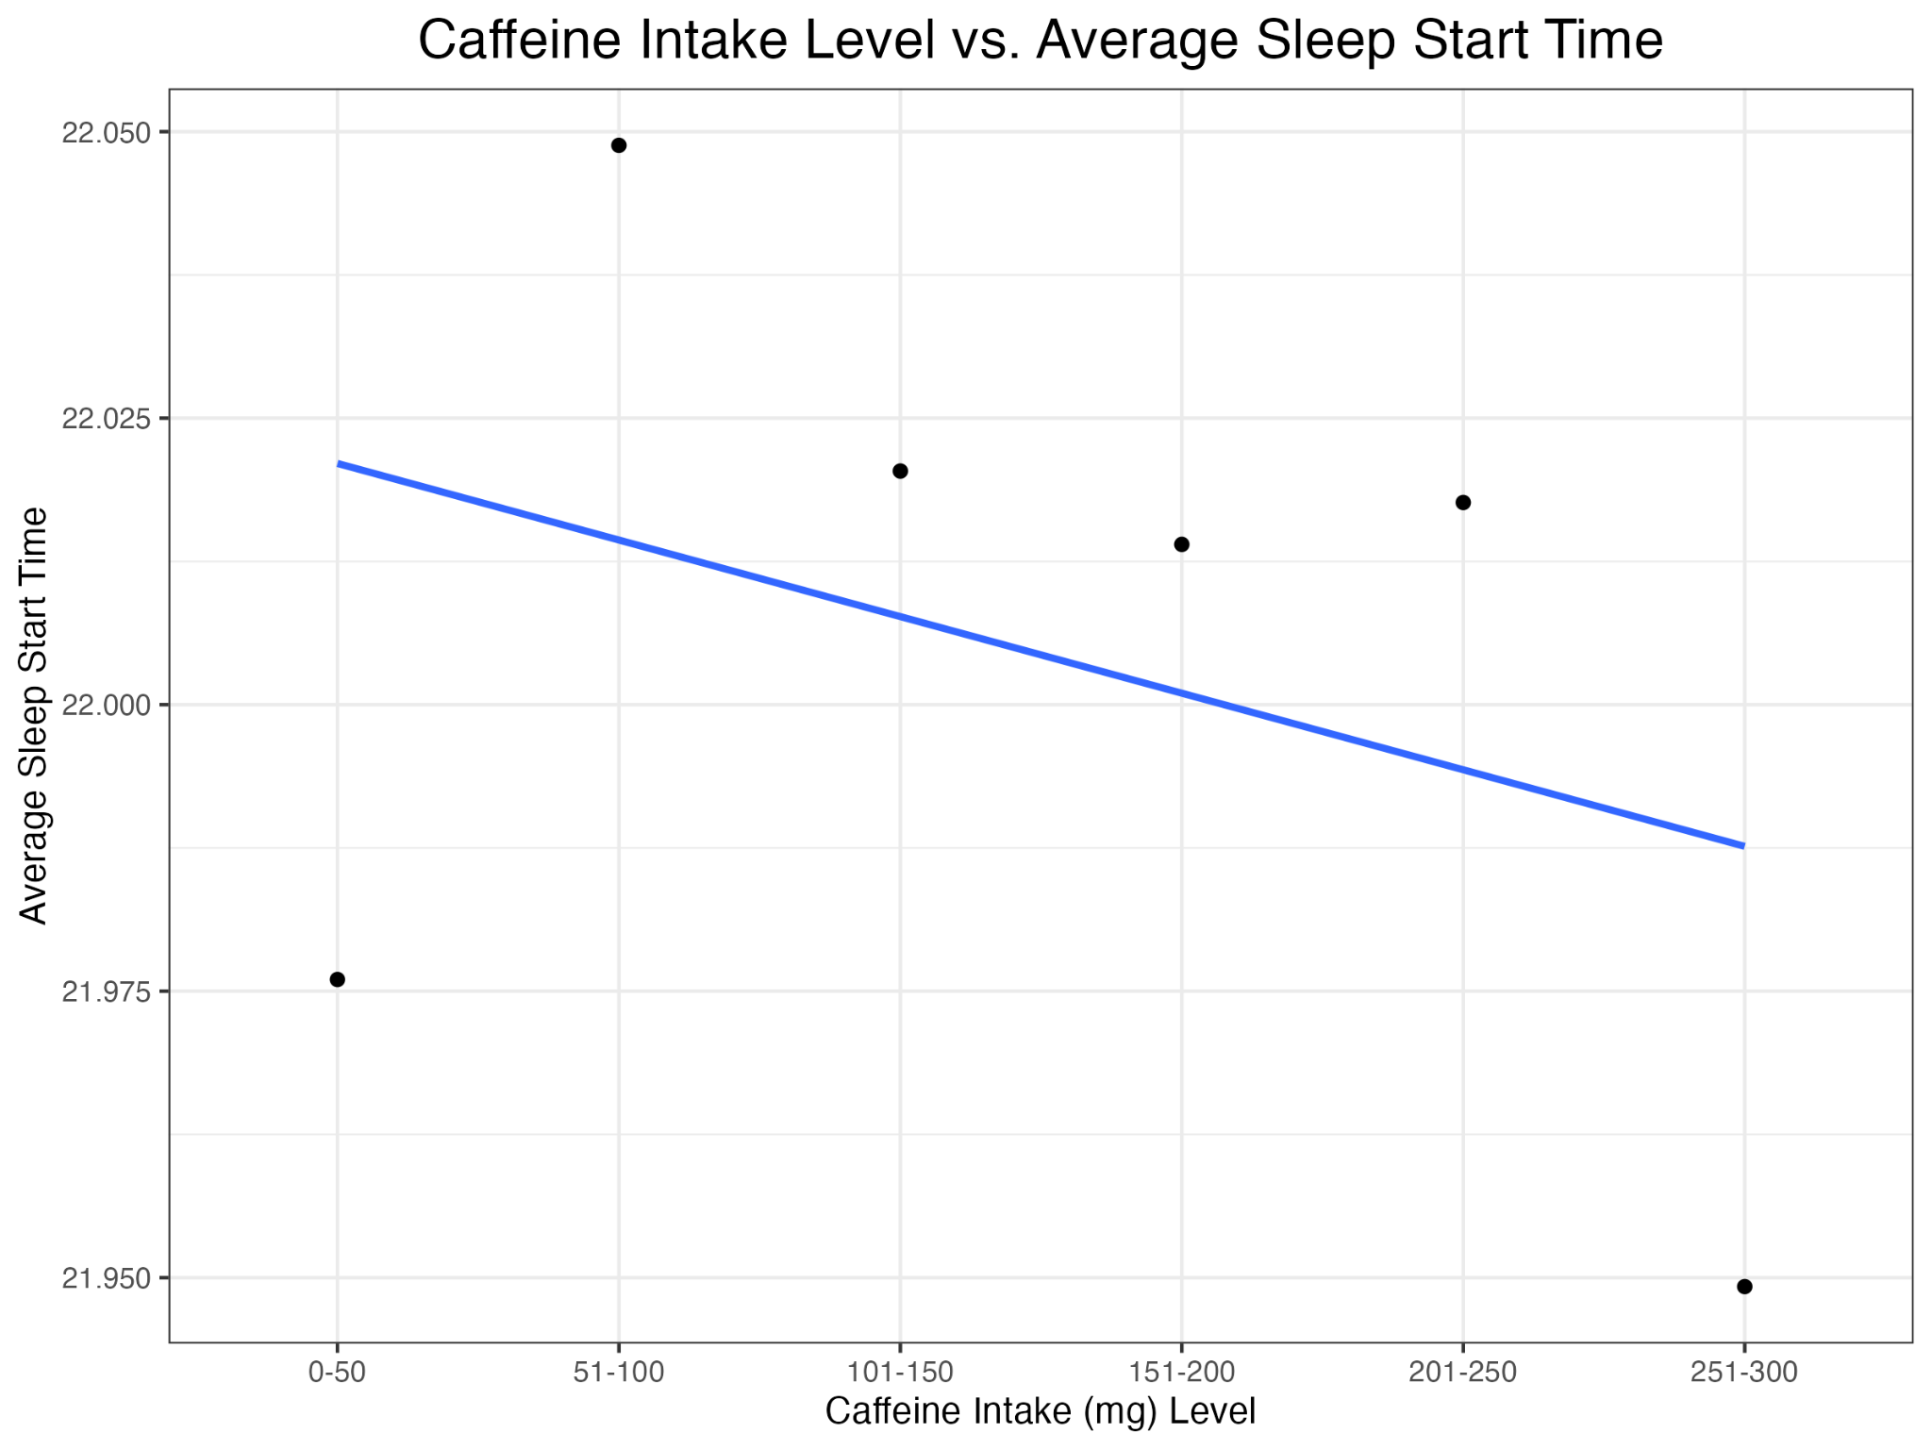
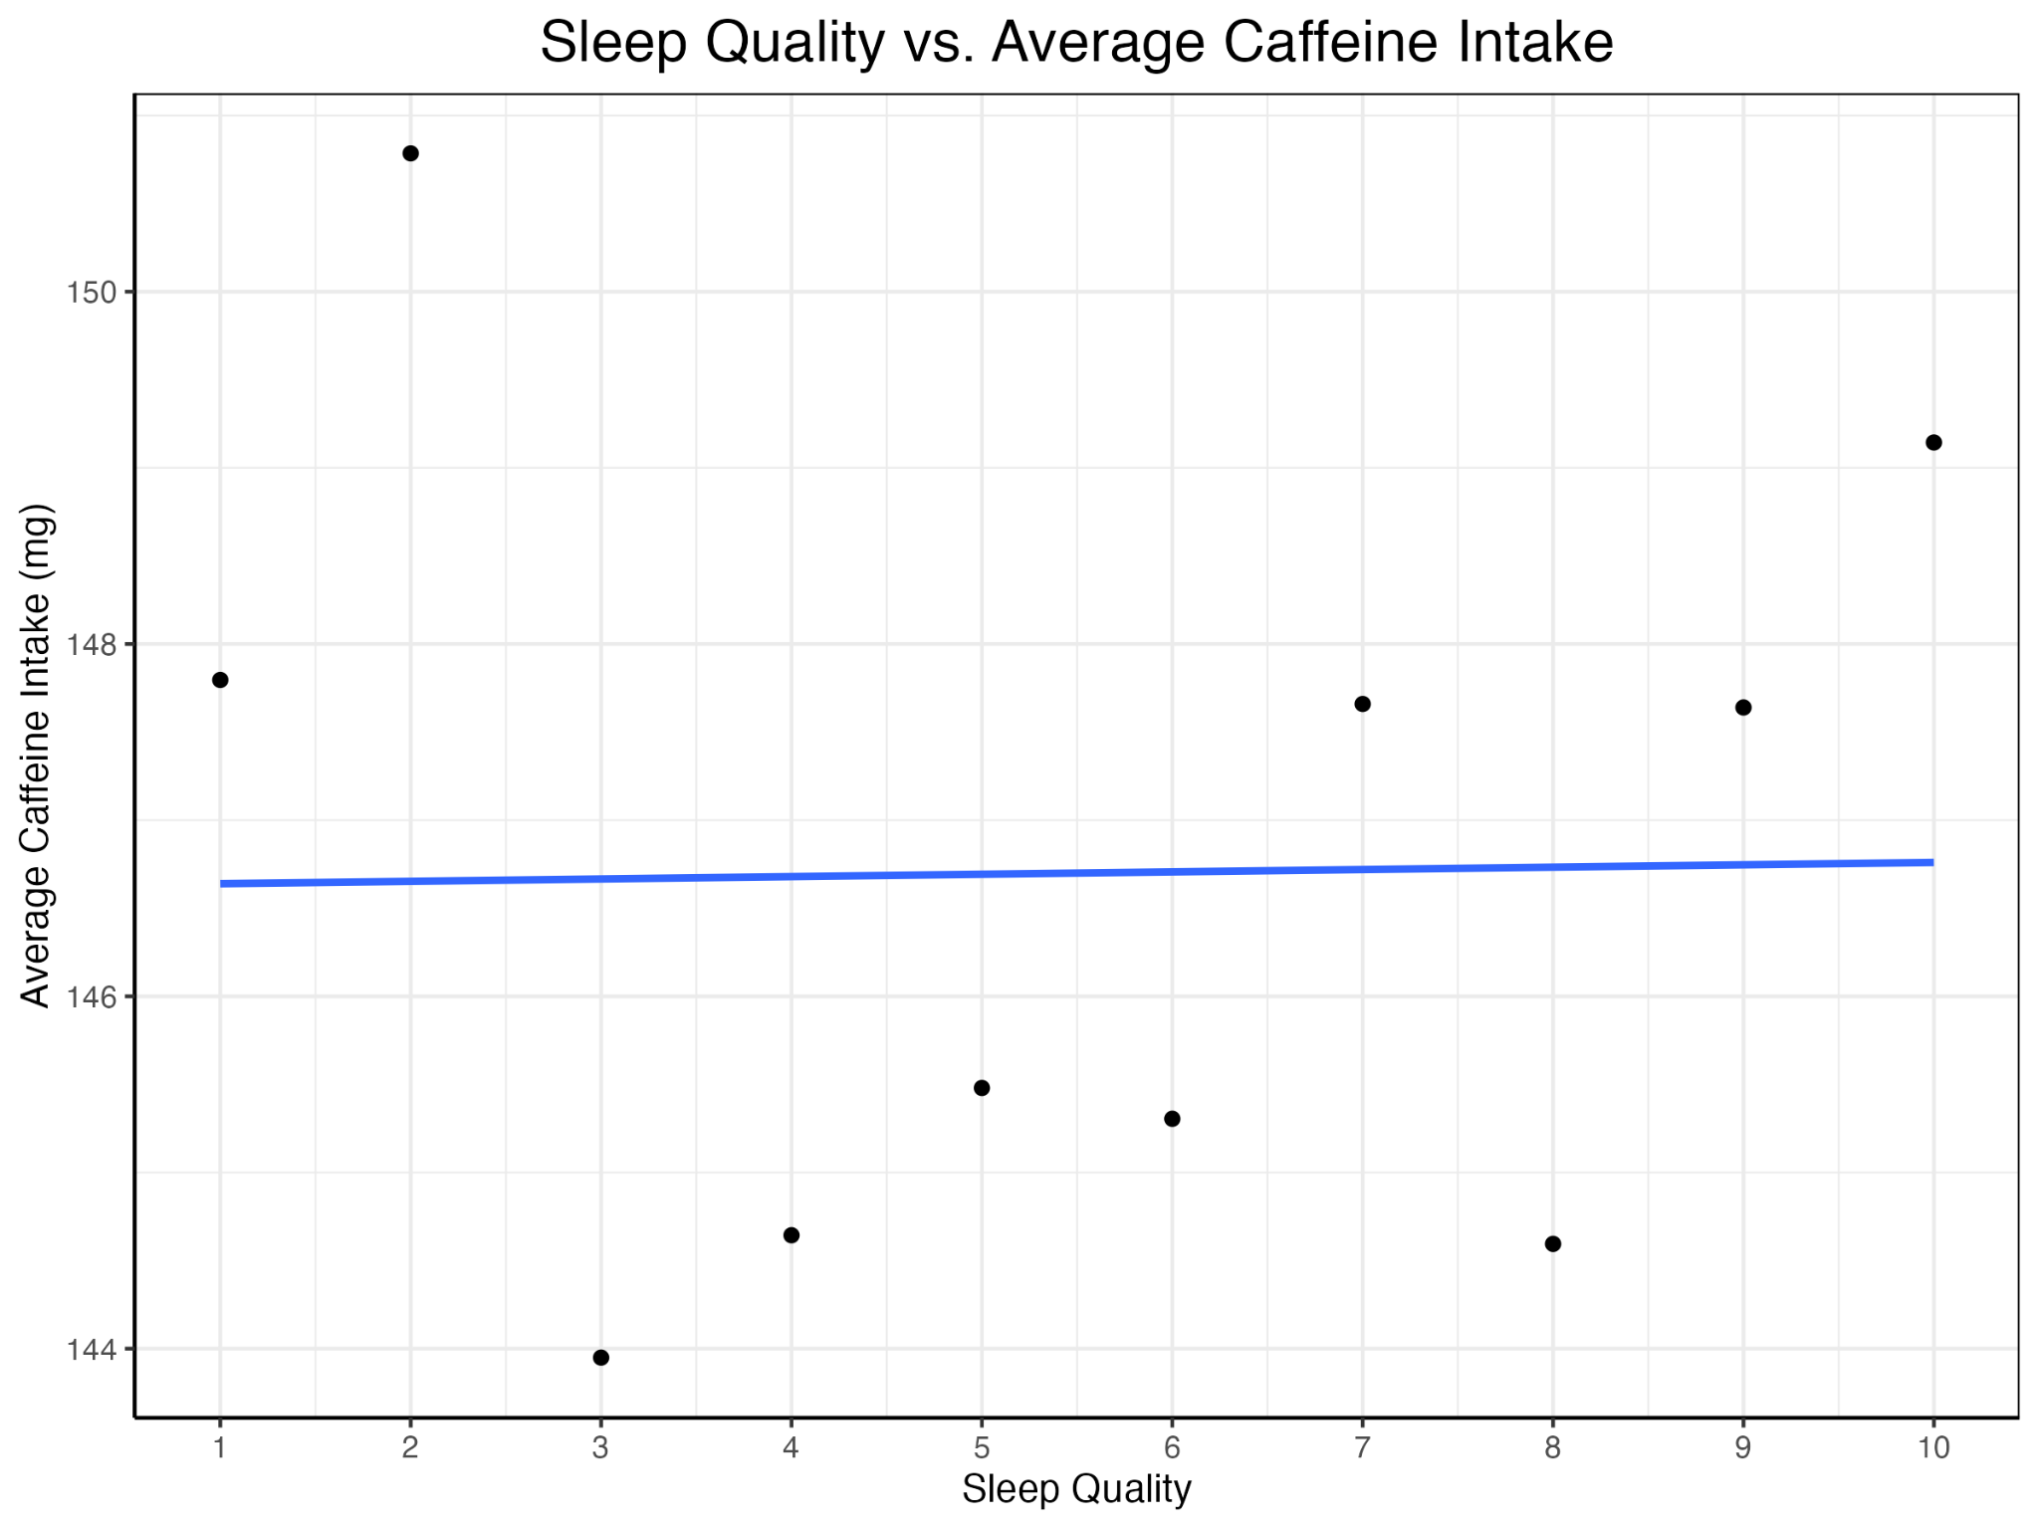
Caffeine Intake
Lu Liang
BIS 15L Group7_Psychology
Correlation coefficient: -0.003353004
Correlation coefficient: 0.0006685539

Slide 13
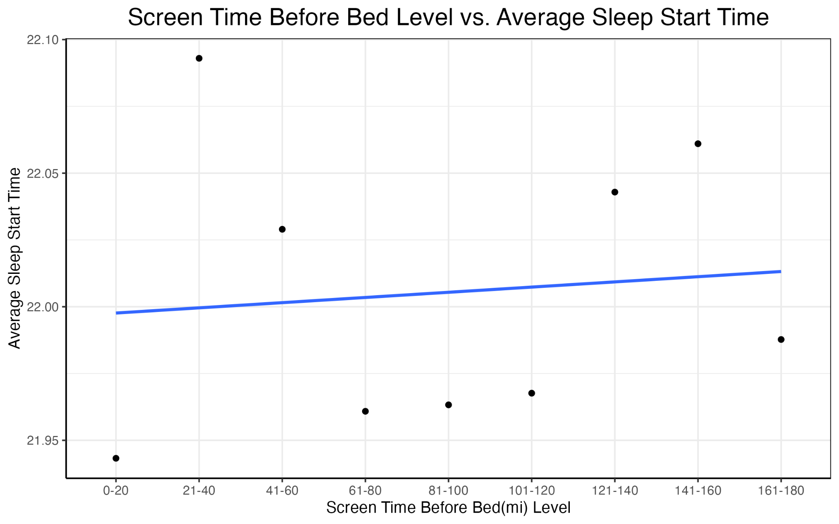
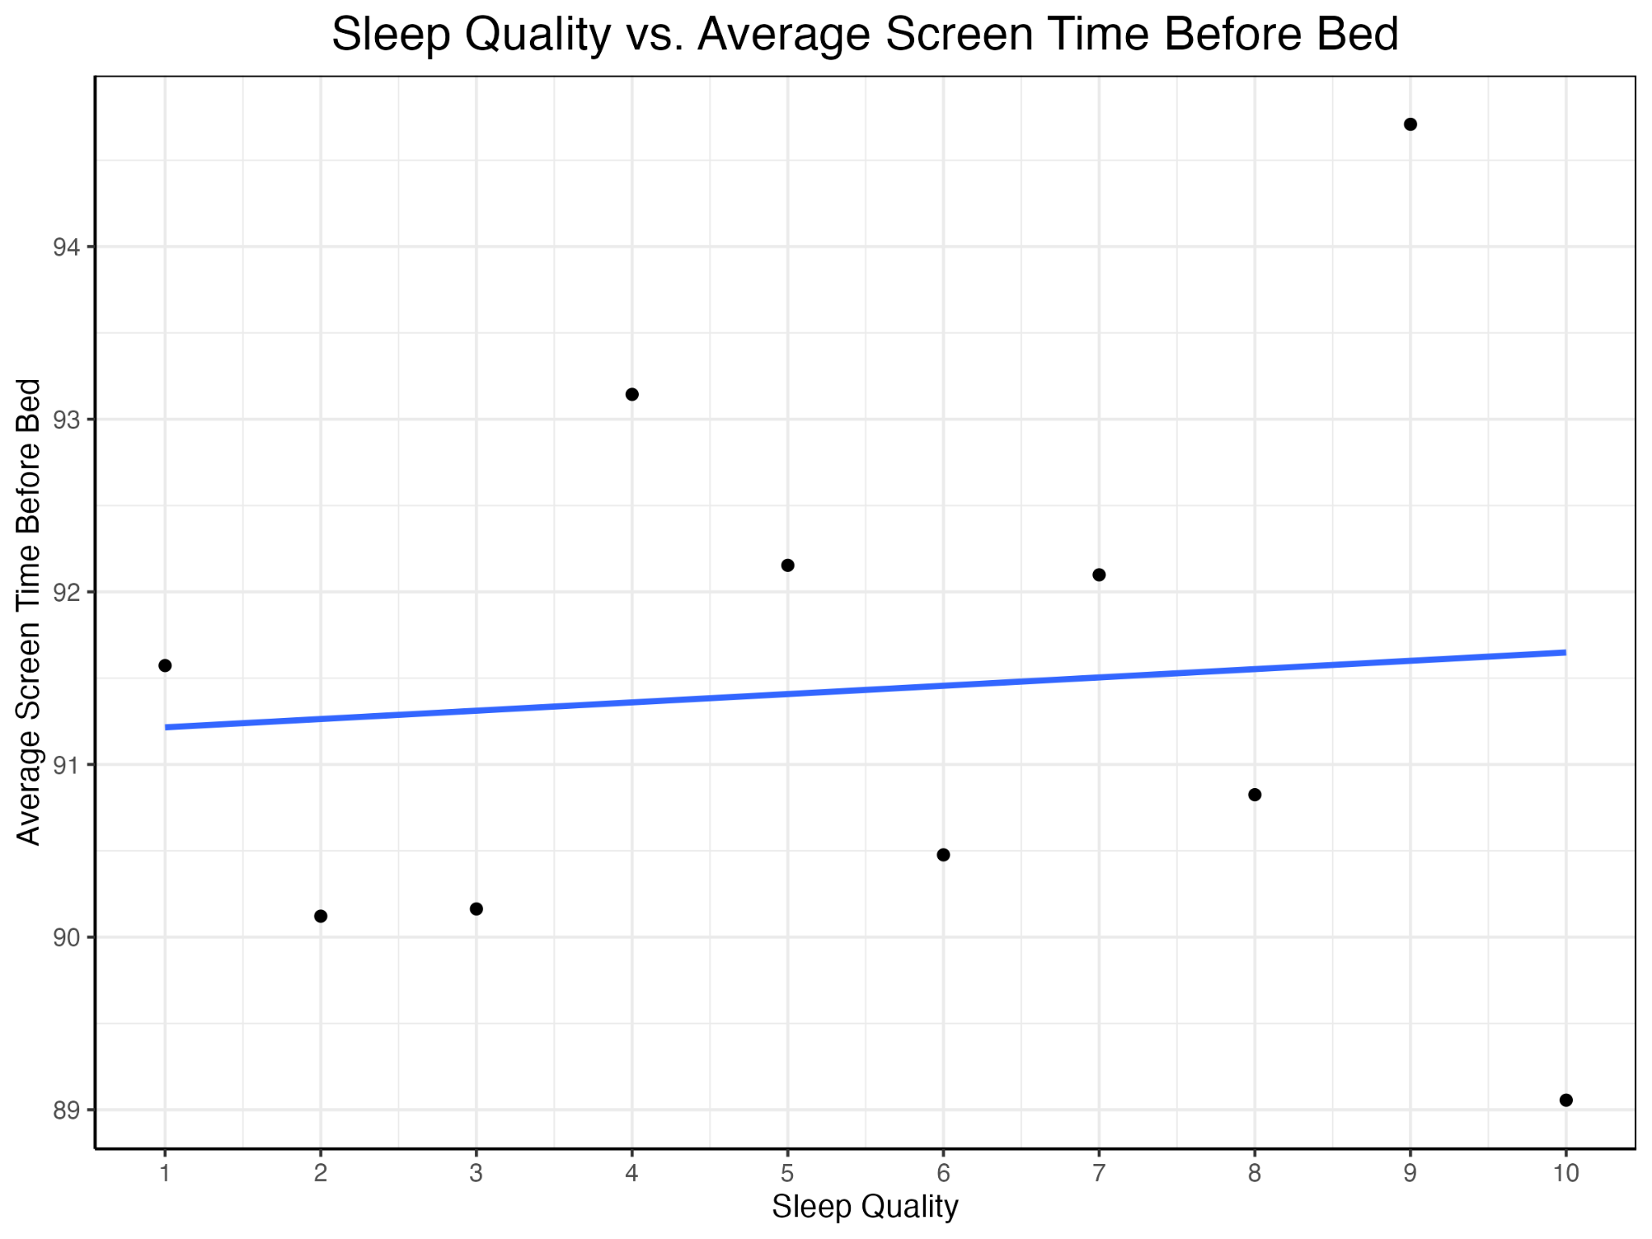
Screen Time Before Bed
Lu Liang
BIS 15L Group7_Psychology
Correlation coefficient: 0.005332368
Correlation coefficient: 0.002061734

Slide 14
Conclusions
BIS 15L Group7_Psychology
Sleep is influenced by various factors, and in our analysis, each of these factors shows only weak correlations with sleep.
This could be because ：
Sleep is affected by multiple factors working together.
Data includes subjective variables, such as sleep quality and mood scores, which may introduce bias and prevent objective conclusions.

Slide 15
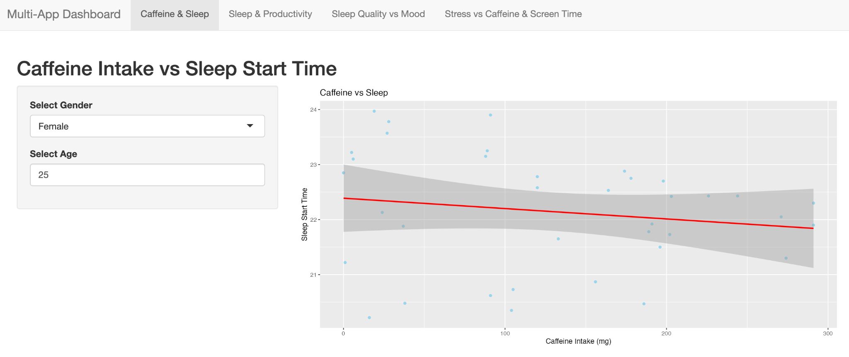
Shiny App
BIS 15L Group7_Psychology
https://github.com/Monetsun/BIS15W2025_group7/tree/main/Shiny%20App

Slide 16
Thank You!
BIS 15L Group7_Psychology
Wish you sweet dreams tonight!

